Slide 1
聲學傳遞函數盲估計以應用於去混響、聲源分離以及增強 Blind estimation of acoustic transfer functions with application to signal dereverberation, source separation, and speech enhancement Date：2024. 07. 24
Telecom Electroacoustics Audio(TEA) Lab
Presenter: 袁安志
Research supervisor : 白明憲
Notes:
Hello everyone
I’m today’s presenter siang. I’m going to share some of my present work in source separation problem. My topic is comparative studies of source separation using semi-blind and blind source separation approaches.

Slide 2
Outline
Chapter 1 Introduction
Chapter 2 Baseline approach
Chapter 3 Signal model
Chapter 4 Proposed method
Chapter 5 Simulations
Chapter 6 Experiments
Chapter 7 Conclusions and Future work
References

Slide 3
Chapter 1 Introduction
Motivation
Literature review

Slide 4

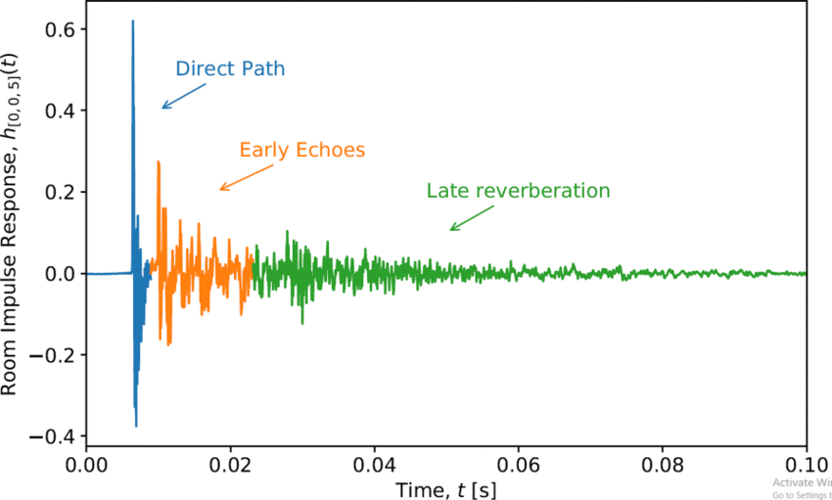


Motivation
Acoustic transfer functions (ATFs) v.s. Relative transfer functions (RTFs)
Unavailability of the source signal
Most blind system identification (BSI) → multiplication transfer function (MTF)
Proposed method → convolutive transfer function (CTF)
ATF
RTF
Amplitude
Time samples

Slide 5
Literature review
Subspace (SS) algorithm
[3]
Higher-order statistics
[1]
Second-order statistics (SOS)
[2]
Cross relation (CR) algorithm
[4]
Slow convergence
local minimum
Blind system identification (BSI)
Computatioally intensive
Difficult in adaptive mode
Time domain adaptive eigenvalue decomposition
algorithm (TAEDA)
[5]
Frequency domain adaptive eigenvalue decomposition
algorithm (FAEDA)
[6]
Short RIR

Slide 6
Chapter 2 Baseline approach

Slide 7
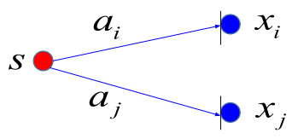
Baseline approach (concept of MCLMS)

Slide 8
Chapter 3 Signal model

Slide 9
Signal model
s(n)
y(n)
a(n)

Slide 10
Chapter 4 Proposed method
Flow chart
TDOA-based source localization
Pre-processing
Wiener filter approach
RLS approach
Kalman approach
ATF reconstruction
Parameters optimization

Slide 11
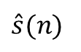
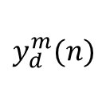
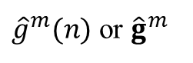

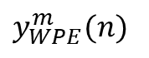
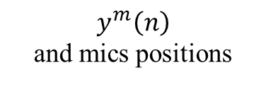
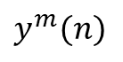

Flow chart
Parameters optimization
$$y_{d}^{m}(n)$$
Signal
delay
Parameters optimization
Wiener filter approach
RLS approach
Kalman filter approach
$\hat{A}$
Pre-processing
ATF reconstruction
Weighted
prediction
error (WPE)
Three CTF coefficients estimated approach
ATF reconstruction
Acoustic
applications
DAS
beamformer
$y^{m}(n)$
s_{DAS,p}
$\hat{A}$
${\hat{g}}^{m}(n)$ or ${\hat{g}}^{m}$
$\hat{s}(n)$
$y_{WPE}^{m}(n)$
TDOA-based source localization
source position
$$y^{m}\left(n\right)$$
and mics positions
TDOA-based source localization

Slide 12
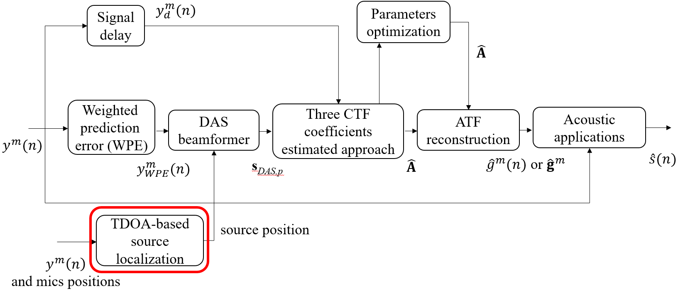
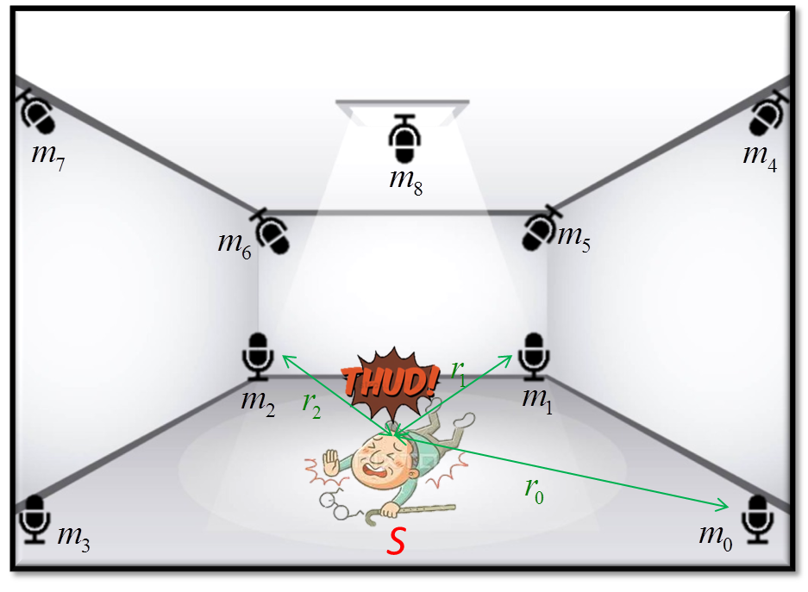
TDOA-based source localization

Slide 13
TDOA-based source localization

Slide 14
TDOA-based source localization

Slide 15
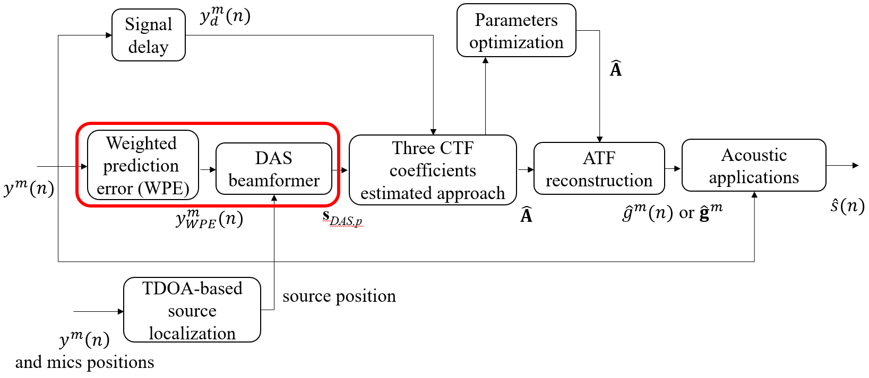
Pre-processing
WPE
Signal formation
Algorithm for WPE
DAS Beamformer

Slide 16
Signal formation
Time samples
D

Slide 17
Signal formation

Slide 18
Algorithm for WPE

Slide 19
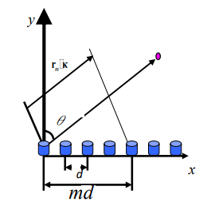
DAS beamformer
r^{m}

Slide 20
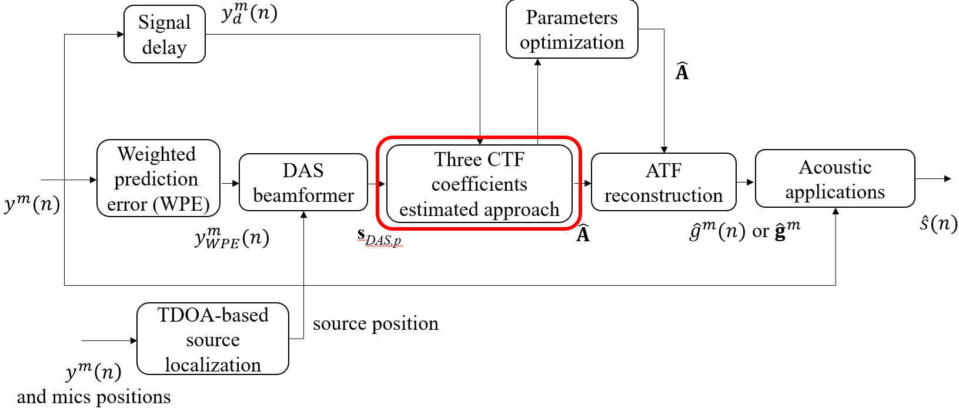
Wiener filter approach
RLS approach
Kalman filter approach

Slide 21
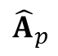
Wiener filter approach
y_{d,p}
s_{DAS,p}
R_{ss,p}
R_{sy,p}
${\hat{A}}_{p}$
Recursive average
Wiener filtering

Slide 22
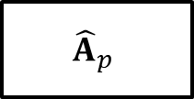
RLS approach
s_{DAS,p}
-
y_{d,p}
₊
$${\hat{A}}_{p}$$
∑
e_{p}

Slide 23
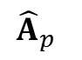
Kalman filter approach
y_{d,p}
s_{DAS,p}
Measurement update
(correction)
P_{Kalman,p│p}
$${\hat{A}}_{p}$$
P_{Kalman,p│p-1}
P_{Kalman,p-1│p-1}
No time update (prediction)

Slide 24
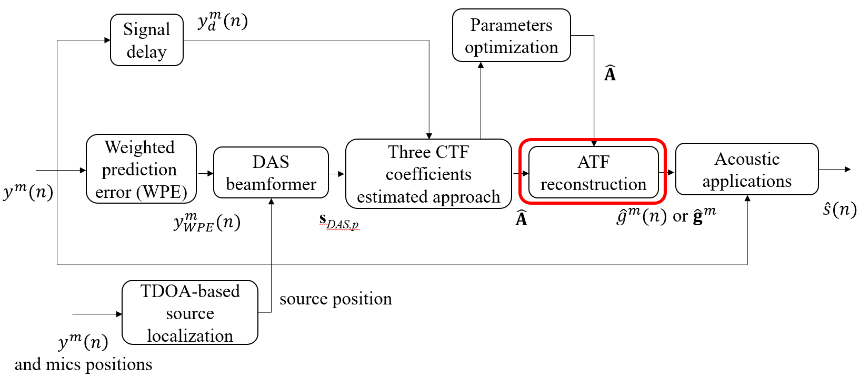
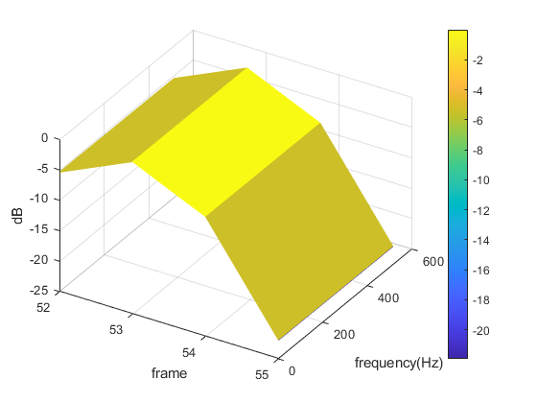
ATF reconstruction
δ_{p}
(k)

Slide 25
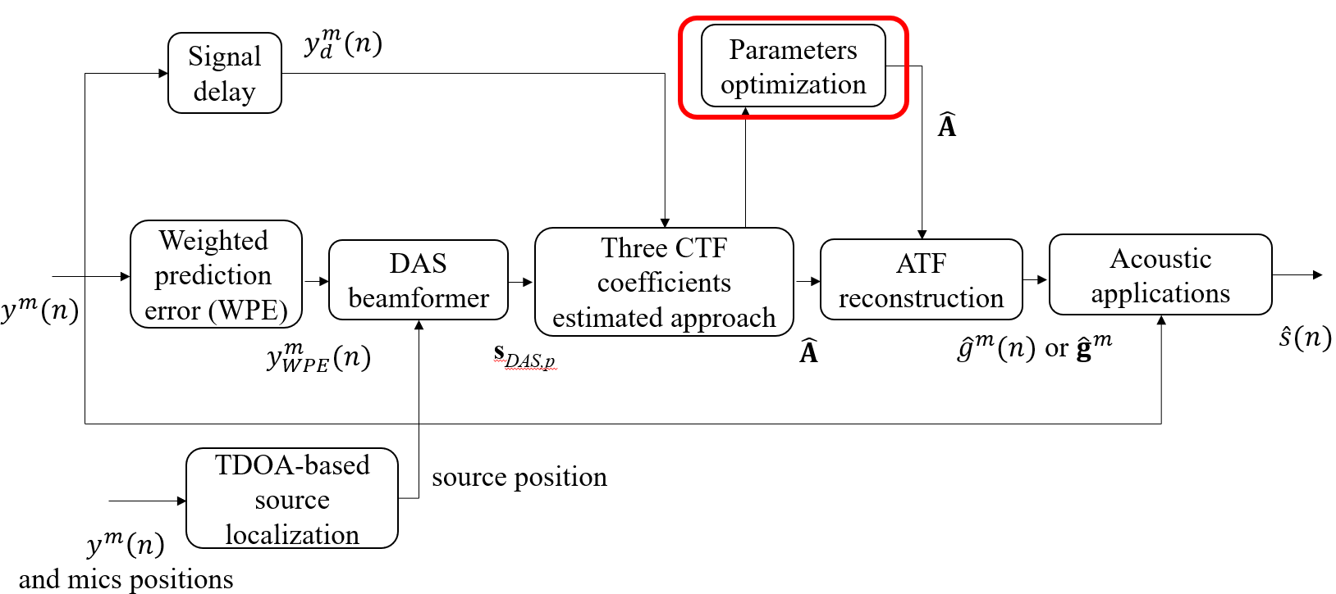
Parameters optimization
Which parameter ?
PSO
Concept of PSO
Flow chart of PSO
Equations of PSO
ASPSO
Flow chart of ASPSO

Slide 26
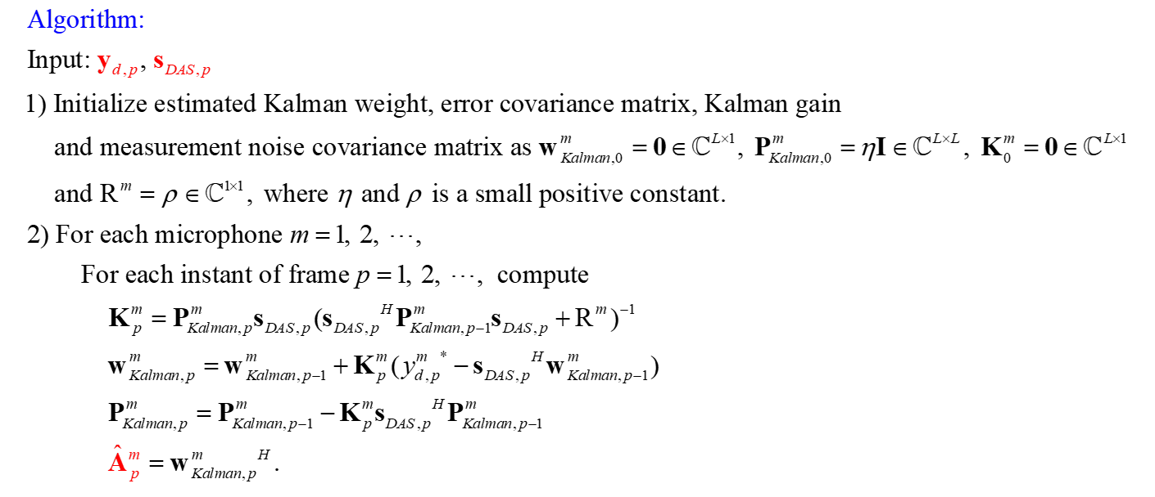
Which parameter?

Slide 27
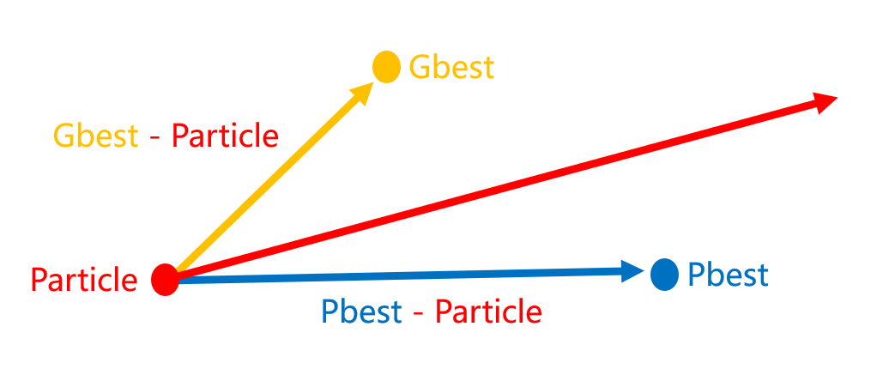
Concept of PSO
Personal best location & Global best location
Global exploration ←→ Local exploitation

Slide 28
Flowchart of PSO
Randomly initialize particle locations X and velocities V
Calculate fitness of particle
Update pbest gbest
Stopping criteia met?
Output gbest
Yes
No
Update particle velocities and locations

Slide 29
Equations of PSO

Slide 30
Flowchart of ASPSO
Output gbest
Randomly initialize particle locations X and velocities V
Yes
No
Stopping criteia met?
4. Competitive substitution mechanism
Calculate fitness of particle
Update gbest
Update pbest gbest
1. Inertia weight with chaotic
Update pbest
Update inertia weight w_{in}
Replace the particle with the worst fitness
Select Cpbest
Calculate Fpbest
Calculate Mpbest
Update particle position
2. Elite and dimensional learning strategies
Update particle position using spiral-shaped mechanism
Update particle velocity
Yes
3. Adaptive position update strategy
β < rand?
No

Slide 31
Chapter 5 Simulations
Fixed source location cases
Fixed source location with parameters optimization
Applications of estimated ATFs and RIRs
Moving source location cases

Slide 32
Fixed source location cases
Settings
Results

Slide 33
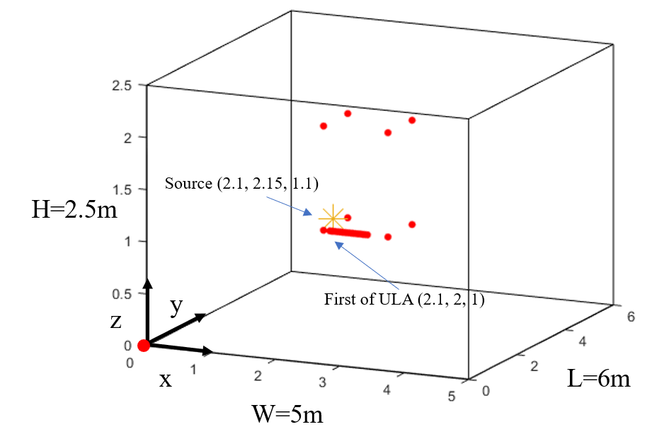
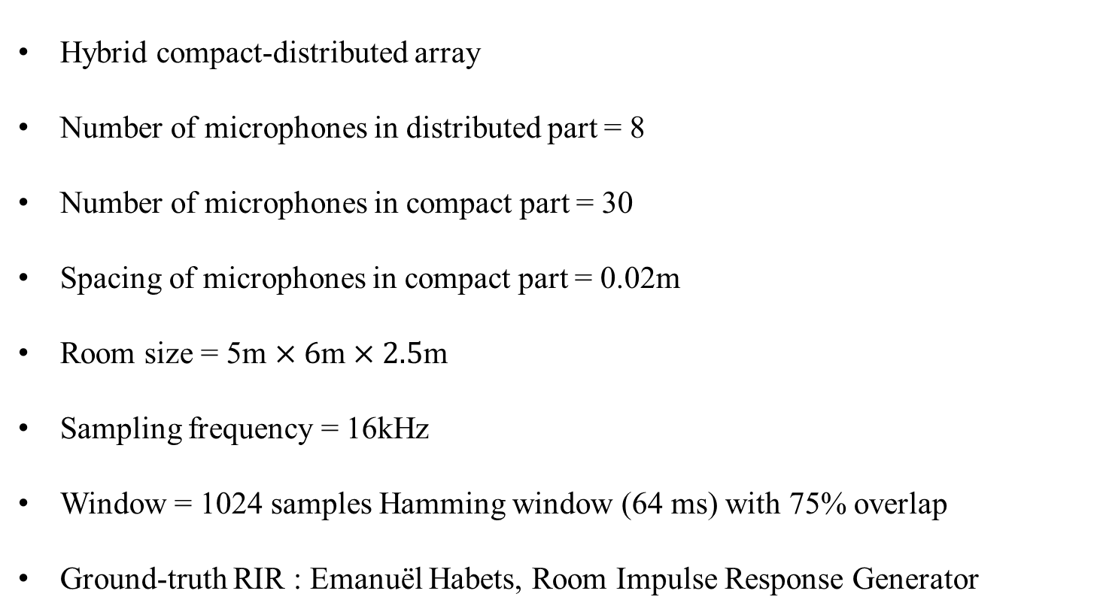
Settings
Hybrid compact-distributed array
Number of microphones in distributed part = 8
Number of microphones in compact part = 30
Spacing of microphones in compact part = 0.02m
Room size = 5m $×6$m $×2.5$m
Sampling frequency = 16kHz
Window = 1024 samples Hamming window (64 ms) with 75% overlap
Ground-truth RIR : Emanuël Habets, Room Impulse Response Generator
First mic of ULA

Slide 34
Results
T₆₀ = 0.01s

Slide 35
Results
T₆₀ = 1.6s

Slide 36
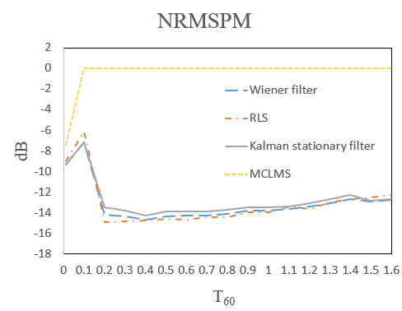
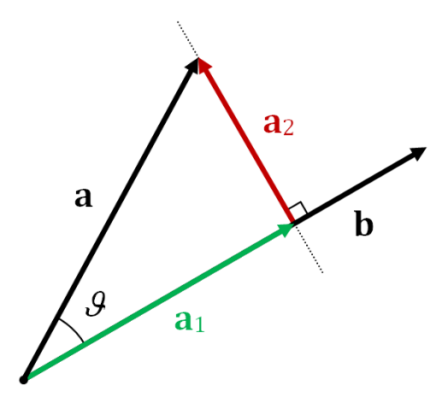



Results
$$ψ$$
$$g$$
$$\hat{g}$$

Slide 37
Fixed source location with parameters optimization
Results

Slide 38
Results
Method | NRMSPM (dB)
Kalman filter without parameters optimization | -13.2238
Kalman filter with PSO | -13.5870
Kalman filter with ASPSO | -13.5873

Slide 39
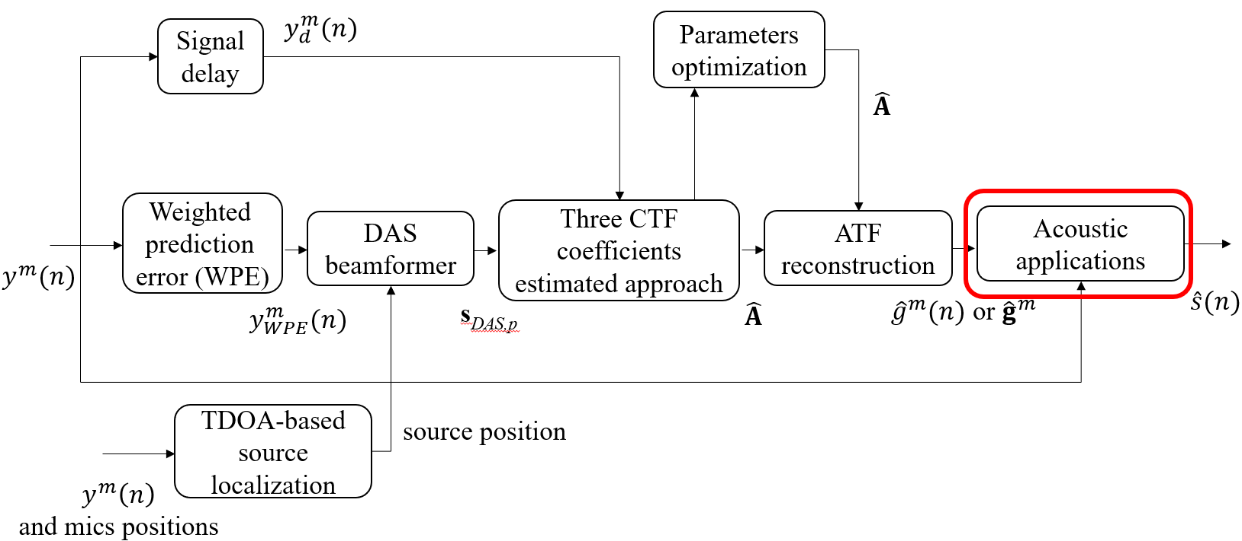
Applications of estimated ATFs and RIRs
MINT dereverberation
Settings of TIKR and MPDR
TIKR source separation results
MPDR speech enhancement results

Slide 40
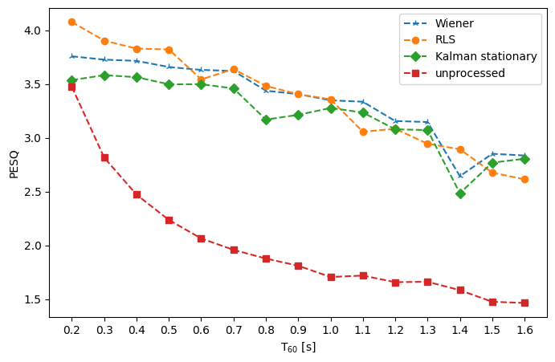
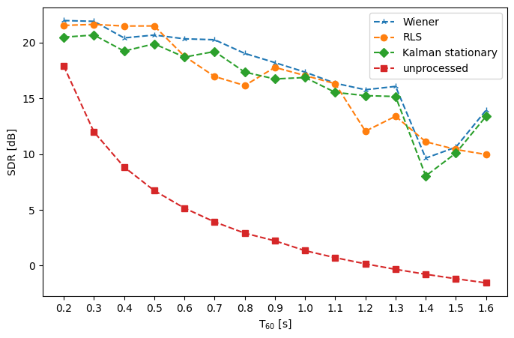
MINT dereverberation
Perceptual Evaluation of Speech Quality (PESQ)
range: [-0.5 4.5]

Slide 41

MINT dereverberation
 | Ground-truth source | Unprocessed signal | Wiener filter | RLS | Kalman filter
T₆₀ = 0.6s
T₆₀ = 1.0s
T₆₀ = 1.6s

Slide 42
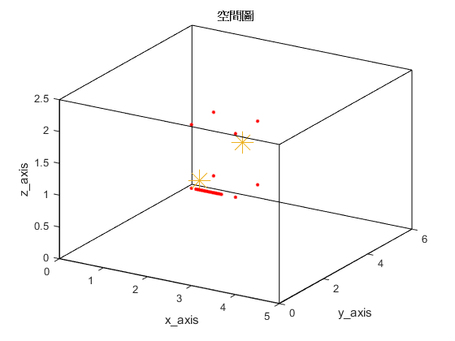
Settings of TIKR and MPDR
Source 1
Source 2 or interferer
y
z
First mic of ULA
x

Slide 43
TIKR source separation results
T₆₀ (s) | 0.2 | 0.4 | 0.6
PESQ of source 1 | 3.8347 | 3.6683 | 3.5515
PESQ of unprocessed signal | 1.7486 | 1.5969 | 1.5046
SDR of source 1 (dB) | 26.2406 | 23.4508 | 22.8719
SDR of unprocessed signal (dB) | 4.7966 | 2.4419 | 0.5752
T₆₀ (s) | 0.2 | 0.4 | 0.6
PESQ of source 2 | 2.976 | 2.7389 | 2.7366
PESQ of unprocessed signal | 1.2467 | 1.2444 | 1.219
SDR of source 2 (dB) | 10.5134 | 8.0219 | 9.8436
SDR of unprocessed signal (dB) | -5.3411 | -5.277 | -5.8869
Source 1
Source 2

Slide 44
TIKR source separation results
 | Ground-truth signal | Unprocessed signal | TIKR separated signal
Source 1
Source 2
T₆₀ = 0.6s

Slide 45
MPDR speech enhancement results
T₆₀ (s) | 0.2 | 0.4 | 0.6
PESQ of enhanced speech signal | 1.8859 | 1.7416 | 1.6923
PESQ of unprocessed signal | 1.7486 | 1.5969 | 1.5046
SDR of enhanced speech signal (dB) | 4.3434 | 3.6316 | 3.2715
SDR of unprocessed signal (dB) | 4.7966 | 2.4419 | 0.5752

Slide 46
MPDR speech enhancement results
 | Ground-truth source | Unprocessed signal | MPDR enhanced speech signal
T₆₀ = 0.2s
T₆₀ = 0.4s
T₆₀ = 0.6s

Slide 47
Moving source location cases
settings
results

Slide 48
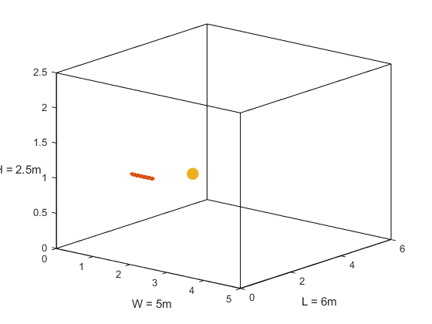
Settings
Moving source
Gap length
First mic of ULA
z
y
x

Slide 49
Results
T₆₀ = 0.4s source spacing = 0.3m
Stationary Kalman filter
Non-stationary Kalman filter

Slide 50
Results
T₆₀ = 0.4s
Movement distance (m) | Filter type | NRMSPM1 (dB) | NRMSPM2 (dB) | NRMSPM3 (dB)
0.1 | stationary | -14.3064 | -0.5501 | -0.0847
0.1 | Non-stationary | -14.0583 | -14.4474 | -13.8963
0.3 | stationary | -14.307 | -0.115 | -0.0094
0.3 | Non-stationary | -13.9327 | -14.1249 | -13.4396

Slide 51
Chapter 6 Experiments
Settings and Parameters
Results

Slide 52
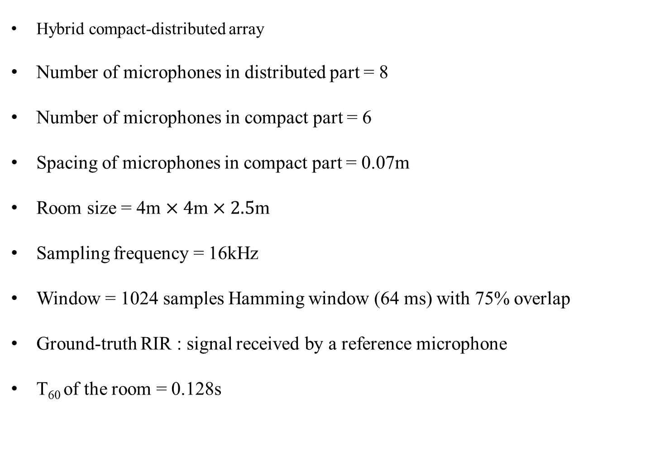
Settings and Parameters
Hybrid compact-distributed array
Number of microphones in distributed part = 8
Number of microphones in compact part = 6
Spacing of microphones in compact part = 0.07m
Room size = 4m $×4$m $×2.5$m
Sampling frequency = 16kHz
Window = 1024 samples Hamming window (64 ms) with 75% overlap
Ground-truth RIR : signal received by a reference microphone
T₆₀ of the room = 0.128s

Slide 53
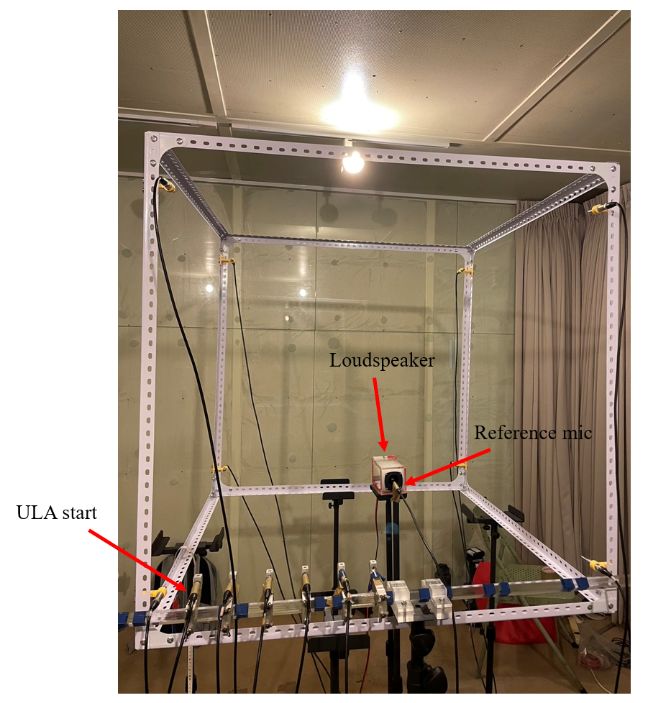
Settings and Parameters

Slide 54
Results
Method | NRMSPM (dB)
Kalman stationary filter | -2.9109
MCLMS | -0.0013
MCLMS (baseline)
Stationary Kalman filter

Slide 55
Chapter 7 Conclusions and future work
Conclusions
Future work

Slide 56
Conclusions
Proposed three approaches
Accurate ATF estimation
lower NRMSPM than MCLMS
Acoustic applications
Notable improvement in processed signal regarding PESQ and SDR
Parameters optimization
Getting Lower NRMSPM than the cases without it
Moving source challenge
Solved by non-stationary Kalman filter

Slide 57
Future work
Applications in time or MTF domain→ CTF domain
Reduce the processing time
Increase the quality of the processed signal
State-of-the-art BSI method → CTF signal model
Omit source localization procedures

Slide 58
References
Y. Sato , “ A method of self-recovering equalization for multilevel amplitude-modulaion IEEE Trans. Commu, vol. 23, no. 6, pp. 679-682, 1975.
L. Tong, G. Xu, and T. Kailath, “A new approach to blind identification and equalization of multipath channels,” Proc. 25th Asilomar Conf. Signals, Syst., Comput, vol. 2, pp. 856–860, 1991.
E. Moulines, P. Duhamel, J. F. Cardoso, and S. Mayrargue, “Subspace methods for the blind identification of multichannel FIR filters,” IEEE Trans. Signal Processing, vol. 43, pp. 516–525, Feb. 1995.
H. Liu, G. Xu, and L. Tong, “A deterministic approach to blind equalization,” Proc. 27th Asilomar Conf. Signals, Syst., Comput, vol. 1, pp. 751–755, 1993.
Y. Huang and J. Benesty, “Adaptive multi-channel least mean square and Newton algorithms for blind channel identification,” Signal Processing, vol. 82, no. 8, pp. 1127–1138, Aug. 2002.
M. A. Haque and M. K. Hasan, “Noise robust multichannel frequency-domain LMS algorithms for blind channel identification,” IEEE Signal Processing Letters, vol. 15, pp. 305–308, 2008.
T. Nakatani, T. Yoshioka, K. Kinoshita, M. Miyoshi and B. -H. Juang, “Speech Dereverberation Based on Variance-Normalized Delayed Linear Prediction,” IEEE Trans. Audio, Speech, Lang. Process., vol. 18, no. 7, pp. 1717–1731, 2010.
Rui ang, Kuangrong Hao, Lei Chen, Tong Wang, and Chunli Jiang, “A novel hybrid particle swarm optimization using adaptive strategy,” Information Sciences, vol. 579, pp. 231-250, 2021.
S. A. U. Islam and D. S. Bernstein, “Recursive Least Squares for Real-Time Implementation,” IEEE Control Systems Magazine, vol. 39, no. 3, pp. 82-85, June 2019.

Slide 59
Q&A

Slide 60


© anchi_0203

Slide 61
Equations of ASPSO
1. Inertia weight with chaotic
2. Elite and dimensional learning strategies

Slide 62
Equations of ASPSO
3. Adaptive position update strategy
4. Competitive substitution mechanism

